Slide 1

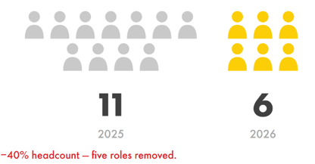
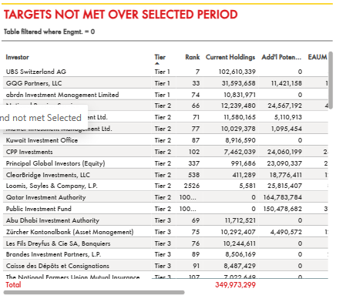
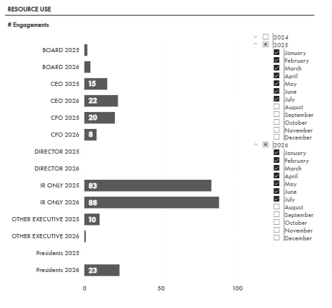
MARKET ENGAGEMENT & EXTERNAL INSIGHTS
Focus leads to More (and Less) with Less
How IR sustained and broadened market engagement with >40% reduction in team size through clearer accountability, data-driven insights from Power BI, and focused deployment of resources .
SHAPE
CONNECT
ACCELERATE
Tom O’Bannon and Kelly Manning
SCA Global Team F2F 2026 | 7–8 September
OPPORTUNITY AND OUTCOME
STARTING CONDITION
Team of 11
Conflicting accountabilities, multiple reporting lines and approaches, excess capacity and a fixed mindset.
THE SHIFT
Focus + data + trust
Clear ownership, reliable Power BI insights, targeted reductions and willingness to test new models.
DESIRED END STATE
Focused team of 6
Clear accountability, a single reporting line, focused deployment, transparency, and trust in each other’s expertise.
ENABLERS: WHAT CHANGED
01 TARGETED REDUCTIONS IN ACTIVITIES
Leverage deep expertise; identify roles and excess capacity that are no longer needed.
02 CLEAR OWNERSHIP
Use a “no stripes” approach where expertise matters more than seniority.
03 DATA THAT DRIVES ACTION
Use Power BI and meaningful meetings to prioritize resources and share information.
04 TEST AND LEARN
Try new models, while knowing when to stick with what works.
05 EXTERNAL ACCOUNTABILITY
Hold external teams accountable. Step back to give other teams room to act quickly.
FROM OPERATING MODEL TO MARKET IMPACT
1 SIMPLER ORGANIZATION
Clearer roles and ownership move decisions closer to expertise.
2 BETTER SIGNALS
Manual tracking → Power BI → prioritized targets and better follow-up.
3 BROADER, FOCUSED REACH
Use brokers at no additional cost, while deploying leaders selectively.
CORE MARKETS
Boston · London · Los Angeles New York · San Francisco
ADDITIONAL REACH
Brussels · Dallas · Denver · Kuala Lumpur Madrid · Singapore · Tokyo
THE MODEL
CLEAR REMITS
DATA DRIVEN
TARGETED MEETINGS
BROADER ENGAGEMENT
KEY LEARNINGS
1
START WITH THE OUTCOME Design the model backward from the result, rather than working toward it incrementally.
2
USE DATA TO ALLOCATE RESOURCES Prioritize CEO, CFO and IR time against the highest-value engagement opportunities.
3
SIMPLIFY ROLES AND ACCEPT RISK Clear ownership enables a smaller team to move faster without duplicating coverage.
WHAT’S NEXT?
Scale through adaptation of AI-supported administrative work, workflow automation and increasingly data-driven engagement.

